Slide 1
Battery SOC and Remaining Charge-Time Estimation from Li-ion Drive-Cycle Data
VUDA JAYA SAI GANESH | Group S2 | TIH, IIT Guwahati
GitHub: https://github.com/SaiGanesh112006/TIH_VUDA_JAYA_SAI_GANESH/tree/main/

Slide 2
Problem and Objectives
• Estimate SOC (%) from voltage, current, temperature, power, ambient temperature
• Estimate remaining charging time (s) in CC-CV segments
• Leakage-safe evaluation: split by file, not by row
• Compare baselines vs Random Forest, XGBoost, MLP
• Deliver a frozen, reproducible package

Slide 3
Project Timeline
• Week 1: problem definition, literature review (8 methods), dataset design, pipeline plan
• Week 2: data audit (208 files), cleaning, preprocessing, frozen split, feature engineering
• Week 3: SOC baselines, ensembles, MLP, tuning; remaining charge-time target built (Day 17) and tuned
• Week 4: model selection by grouped CV, final test of SOC and charge time, failure analysis, package, report

Slide 4
Data Quality Audit
Check | Finding | Decision
Files / rows | 208 CSVs, 6 temperatures, ~4.95M rows | Combine; later use 25°C folder
Duplicates | 5,876 rows (0.12%) | Drop exact duplicates
Invalid voltage | 3 files (non-positive) | Flag, do not auto-delete
Current outliers | 6.75% (IQR) | Flag; high-load pulses
SOC column | Absent in raw data | Derive via coulomb counting

Slide 5
Preprocessing
• 25°C folder, 36 files; every 10th row: 104,560 x 17, 0 missing, 0 duplicates
• Target: SOC = 100 x (1 + capacity_Ah / 3.0), clipped 0-100
• Inputs: voltage_v, current_a, cell_temp_c, power_w, ambient_temp_c (no scaling)
• Leakage columns excluded: capacity_ah, wh_accu, cnt, step, cycle, status, time columns
• Charge-time target: time to end of each CHA segment

Slide 6
Train / Test Split
• GroupShuffleSplit by file_id, test_size 0.2, random_state 42 (frozen Dataset V1)
• Random row split rejected: correlated rows leak across train and test
• Week 2-3: 76,792 train / 27,768 test rows
• Week 4 frozen set: 5,356 rows; 18 train files (5,028 rows), 5 held-out files (328 rows)
• Tuning and selection on training files only; test scored once
• Charge-time target: same file groups; 9 train / 5 held-out files with charging

Slide 7
Feature Engineering
• Lags, deltas, rolling stats, C-rate, temp rise, interactions
• Pruned by correlation > 0.9 and VIF > 10 -> voltage_roll_std5, current_roll_std5
• Result: Linear MAE 3.47 -> 23.19; RF 3.16 -> 22.90
• Decision: engineered features rejected

Slide 8
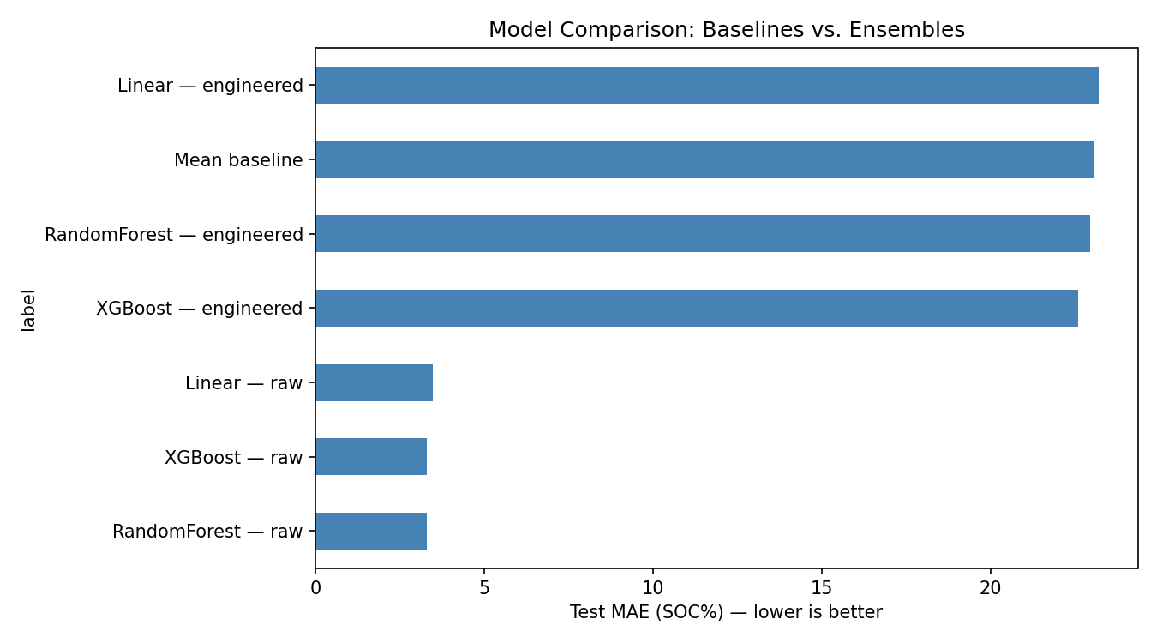
Model Comparison (Week 3)
Method | Features | MAE (%) | RMSE (%) | R²
Mean baseline | - | 23.04 | 27.51 | -0.048
Linear Regression | raw | 3.47 | 4.59 | 0.971
Linear Regression | engineered | 23.19 | 27.77 | -0.068
Random Forest | raw | 3.28 | 10.47 | 0.848
Random Forest | engineered | 22.94 | 28.92 | -0.158
Gradient Boosting (XGBoost) | raw | 3.30 | 10.08 | 0.859
Gradient Boosting (XGBoost) | engineered | 22.60 | 27.53 | -0.049
MLP (ANN) | engineered | 25.93 | 31.61 | -0.384
RF (charging time) | charging | 9,002 s | 18,410 s | -0.160

Slide 9
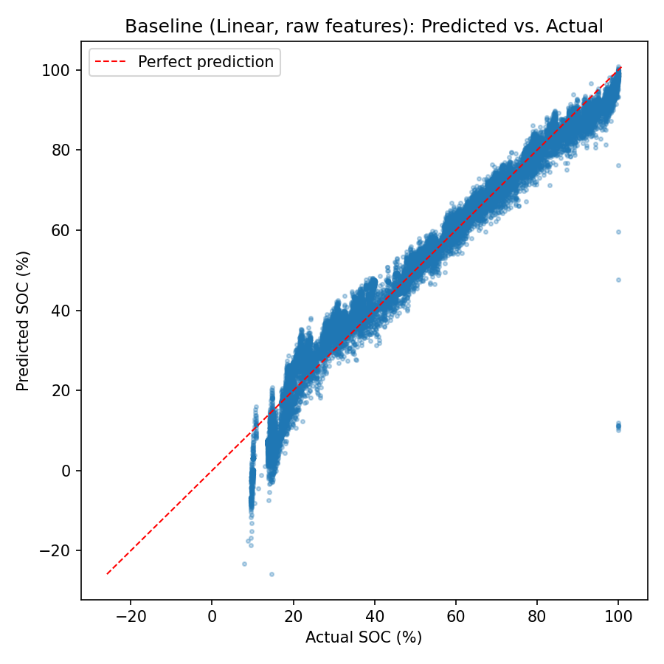
Predicted vs Actual (raw features)

Slide 10
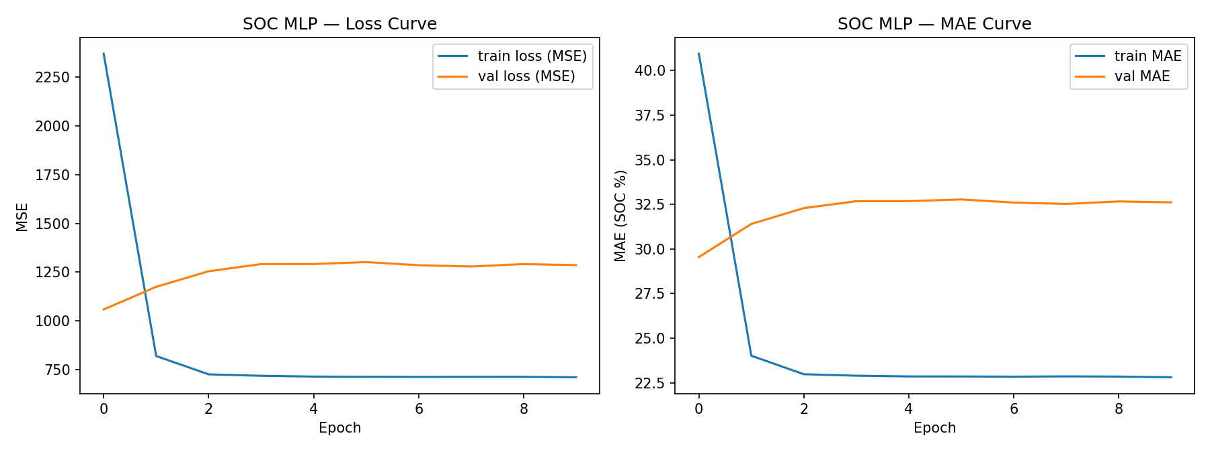
Neural Network (MLP)
• 64-32-1, 2,305 parameters
• Early stopped at epoch 10
• MAE 25.93, R² -0.38 -> rejected

Slide 11
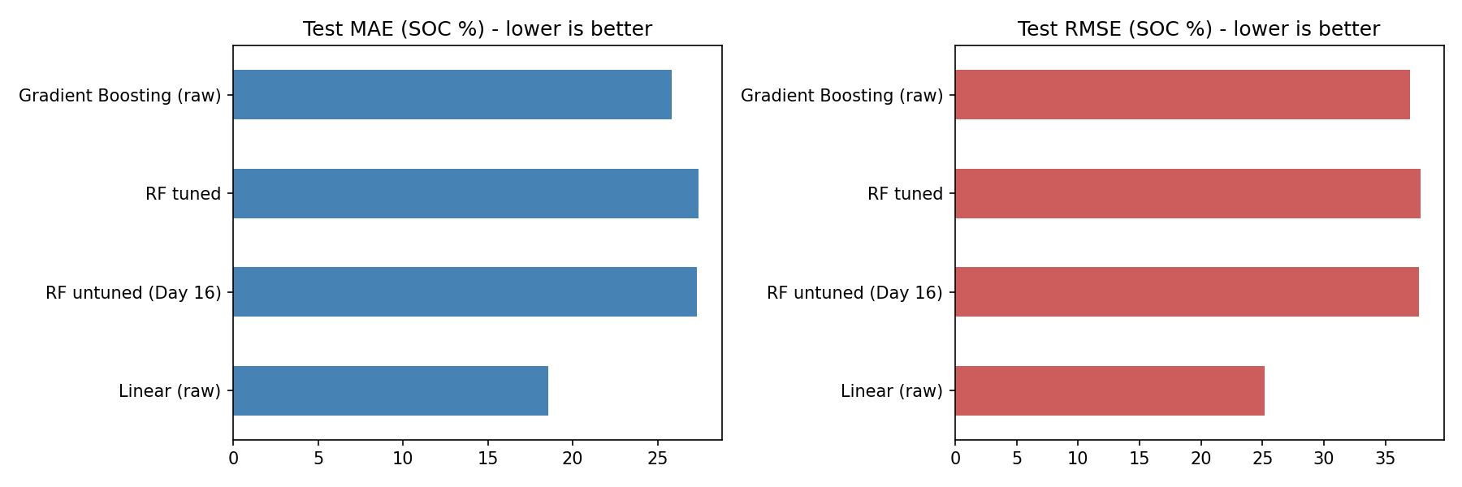
Hyper-parameter Tuning
• Grid on grouped validation split
• Best RF: depth 8, leaf 4, 300 trees
• Early split: MAE 3.28 -> 2.90
• Frozen split: only -0.3% change

Slide 12
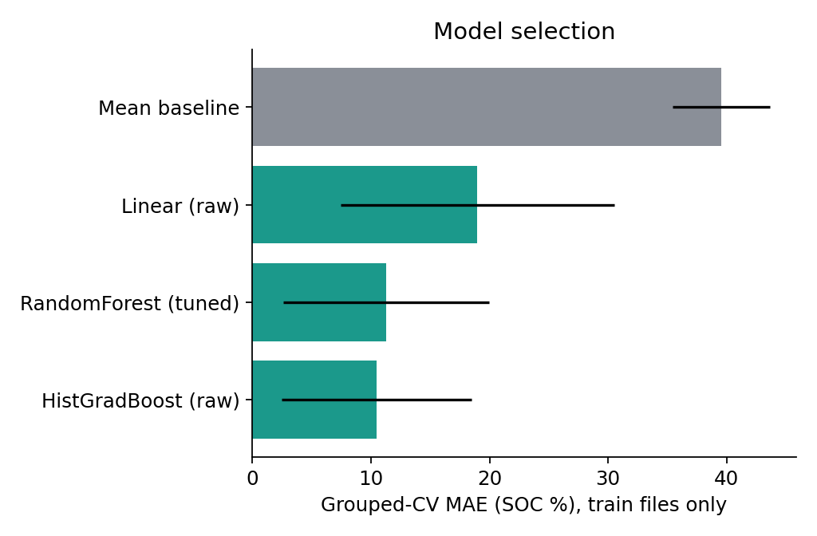
Model Selection (Grouped 5-fold CV)
Model | Rank | CV MAE | CV RMSE | CV R² | Worst-fold MAE
Mean baseline | 0 | 39.551 | 41.769 | -8.591 | 44.118
Linear (raw) | 1 | 18.972 | 29.117 | -8.728 | 29.847
RandomForest (tuned) | 2 | 11.292 | 20.415 | -1.312 | 26.332
HistGradBoost (raw) | 3 | 10.462 | 19.363 | -1.369 | 24.125
• Rule fixed before test: within 10% of best CV MAE -> simplest
• Chosen: RandomForest (tuned)
• Flag: worst fold > 2x mean

Slide 13
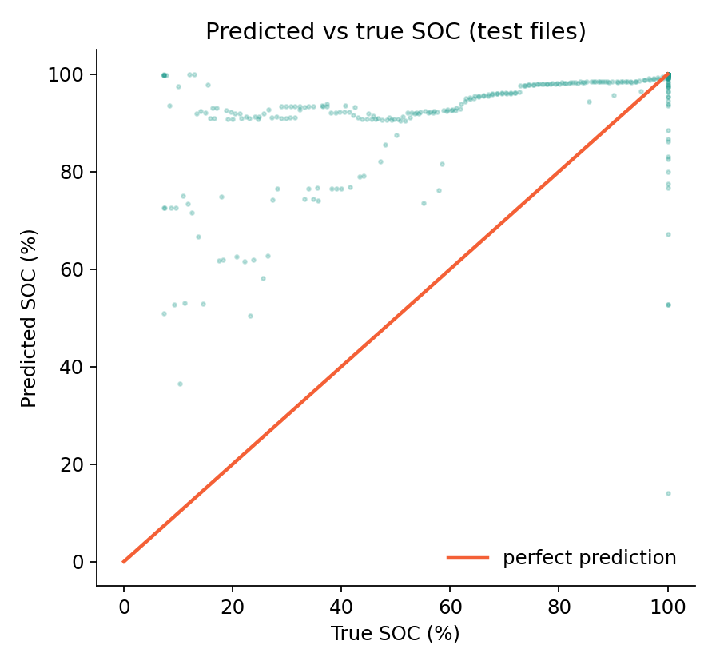
Final Test on Held-out Files
Model | MAE (%) | RMSE (%) | R²
Mean baseline | 28.93 | 32.19 | -0.033
Linear regression (raw) | 18.10 | 25.16 | 0.369
RandomForest (tuned) - frozen final | 27.73 | 37.71 | -0.417
• RF is worse than Linear on unseen files (R² -0.417)
• Linear: 1.3 ms, 0.001 MB vs RF 89.6 ms, 6.1 MB
• Recommendation: revert to the simple baseline
• Charge time: RF MAE 26,626 s vs mean 27,124 s (see next slides)

Slide 14
Remaining Charge Time: Method
• Target: seconds from each row to the end of its contiguous CHA (charging) segment
• Data: 1,299 charging rows, 67 segments; inputs voltage, current, cell temp, ambient temp
• ANN not used: too few, repetitive CC-CV segments (would memorise)
• Random Forest chosen; tuned to max_depth 10, 100 trees (Day 19)
• Early split: MAE 9,002 s; frozen held-out: 153 rows from 5 files

Slide 15
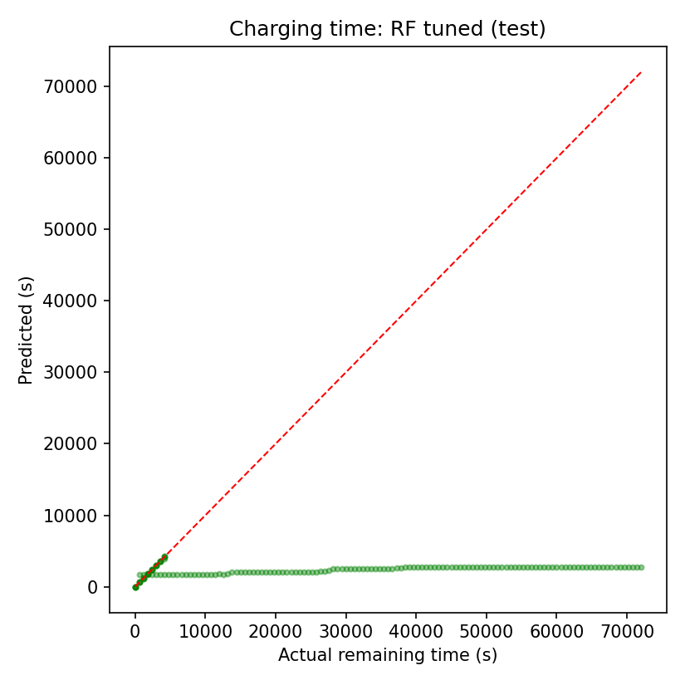
Remaining Charge Time: Results
Model | MAE (s) | MAE (min) | RMSE (s) | R²
Mean baseline | 27,124 | 452.1 | 35,448 | -1.336
Linear | 27,021 | 450.3 | 35,219 | -1.306
Random Forest (tuned) | 26,626 | 443.8 | 35,060 | -1.285
• RF MAE 26,626 s (~444 min), only slightly better than mean baseline
• Low confidence: indicative only

Slide 16
Remaining Charge Time: Error by File
Held-out file | Rows | MAE (s) | Max error (s)
25degC_C20DisCh | 121 | 33,663 | 69,276
25degC_Charge14 | 8 | 39.0 | 270
25degC_Charge15 | 8 | 13.9 | 42
25degC_Charge6 | 8 | 1.9 | 12
25degC_Charge8 | 8 | 6.8 | 42
• 4 true charge files: MAE only 2 to 39 s
• C20DisCh (121 rows tagged CHA) has MAE 33,663 s and dominates the aggregate
• Needs more charge segments and a consistent segment definition

Slide 17
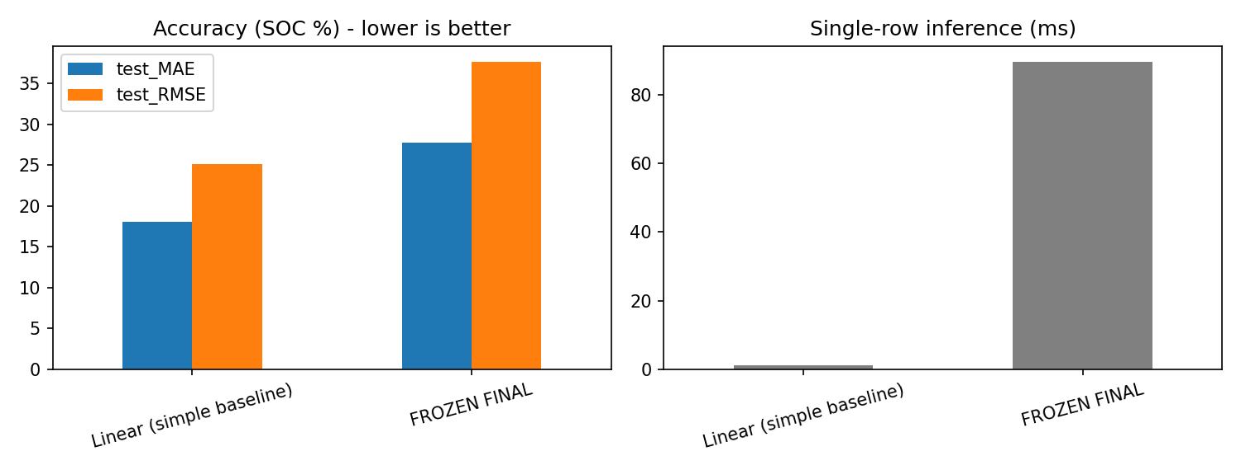
Accuracy vs Complexity

Slide 18
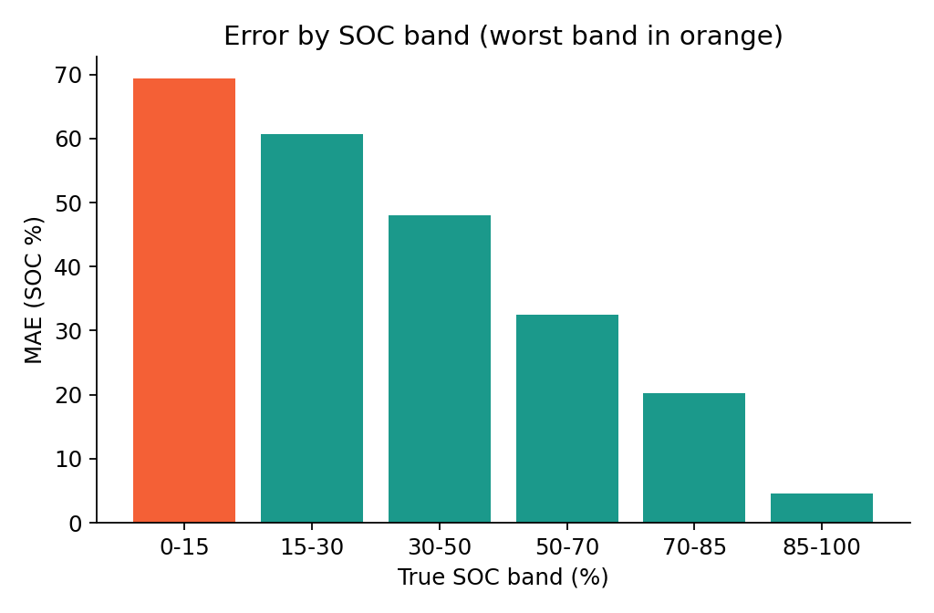
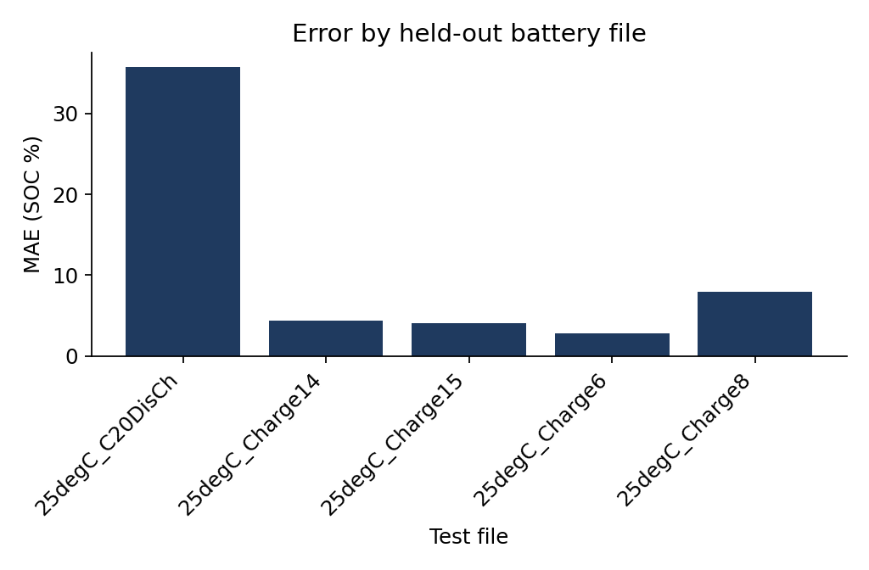
Error Analysis: SOC Bands and Files
Held-out file | MAE (%) | Max error | Rows
25degC_C20DisCh | 35.74 | 92.69 | 243
25degC_Charge8 | 7.90 | 85.95 | 22
25degC_Charge14 | 4.33 | 32.92 | 21
25degC_Charge15 | 4.10 | 47.32 | 21
25degC_Charge6 | 2.77 | 22.45 | 21

Slide 19
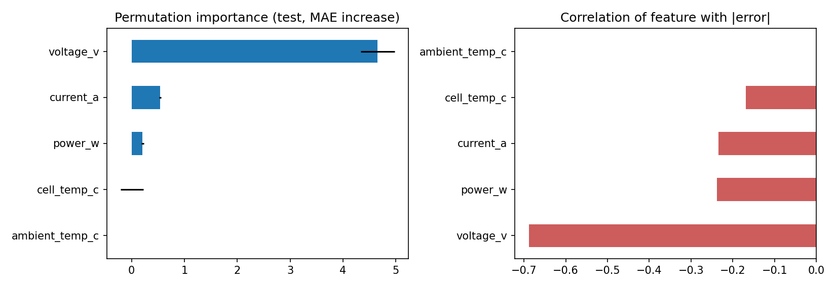
Feature Importance

Slide 20
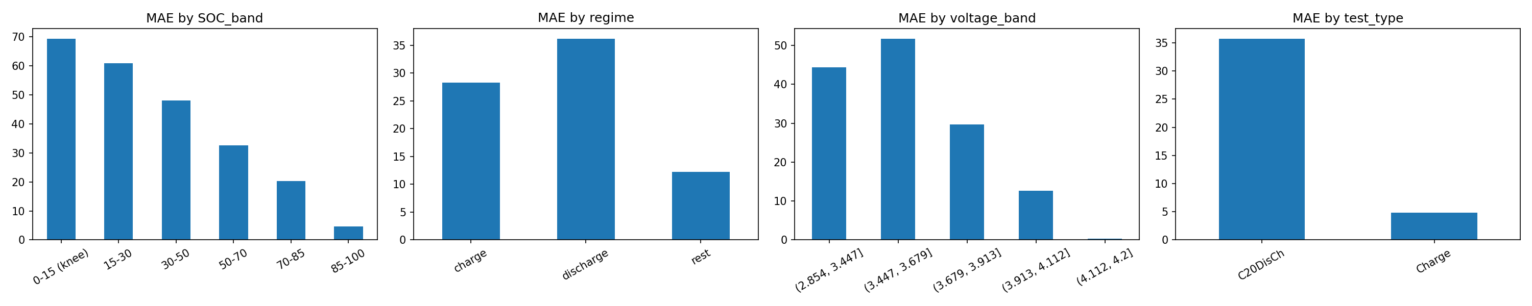
Errors by Operating Condition

Slide 21
Limitations
• Only 5 held-out files / 328 rows
• Worst at SOC 0-15% (MAE 69%); one discharge file carries ~97% of squared error
• Charge time: only 5 files, one long file dominates error
• Only 25°C data; no history in model; V, I, P collinear
• Early MAE ~3% results were on a larger, easier split; not comparable with final

Slide 22
Software Package and Reproducibility
• battery_soc module: config, data, models, train, evaluate, predict
• Frozen models + frozen_config.json, pytest tests, example I/O
• predict.py --model-dir models --input data/sample_input.csv
• Repo: https://github.com/SaiGanesh112006/TIH_VUDA_JAYA_SAI_GANESH/tree/main/

Slide 23
Conclusion and Future Work
• Leakage-safe grouped evaluation exposed that optimistic MAE ~3% does not generalise
• SOC: Linear on raw features (MAE 18.1%) beats tuned RF (27.7%) on unseen files
• Remaining charge time: RF MAE 26,626 s overall; 2 to 39 s on standard charge files; needs more segments
• Next: GRU/LSTM sequence models, multi-temperature data, uncertainty estimates, more charge segments

